Slide 1
Routing In VLSI Design
Notre Dame University Bangladesh
Presented By :
Md Moinul Islam
ID : 3-16120103
CSE

Slide 2
Outline
Routing
Routing Problem
Routing Regions
Types of Routing
Global Routing
Detailed Routing
Conclusion
References

Slide 3
Routing
The Routing is to locate a set of wires in the routing space that connect all the nets in the net list. The capacities of channels, width of wires, and wire crossings often need to be taken into consideration .

Slide 4
The Routing problem
Apply after placement
Input:
Netlist
Timing budget for, typically critical nets
Locations of blocks and locations of pins
Output:
Geometric layout of all nets
Objective:
Minimize the total wire length, the number of vias, or just completing all connections without increasing the chip area.
Each net meets its timing budget.

Slide 5
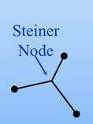
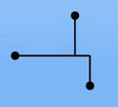
Tree
For a multi-terminal net, we can construct a spanning tree to connect all the terminals together.
But the wire length will be large.
Better use Steiner Tree:
A tree connecting all terminals and some Node additional nodes (Steiner nodes).
Rectilinear Steiner Tree:
Steiner tree in which all the edges run horizontally and vertically.

Slide 6
Routing is hard
Minimum Steiner tree problem :
Given a net , find the Steiner tree with the minimum length
This is NP-complete
May need to route tens of thousands of nets simultaneously without overlapping.
Obstacles may exist in the routing region.

Slide 7
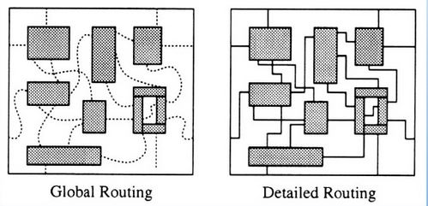
General Routing Problem
Two phases:

Slide 8
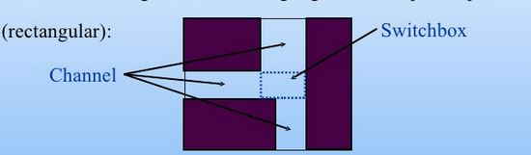
Region Definition
Divide the routing area into routing regions of simple shape
(rectangular):
Channel: pins on 2 opposite side
2D switchbox: pins on 4 sides
3D switchbox pins on all 6 sides

Slide 9
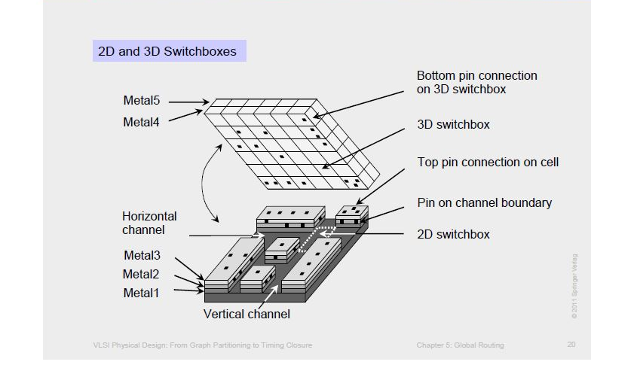
Routing Region

Slide 10
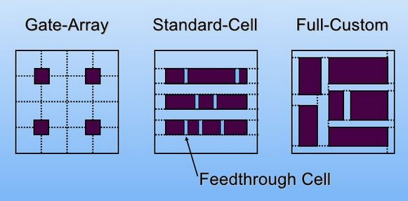
Routing region in different design styles

Slide 11
Type of routing
Routing
Global routing
Detailed routing
Line routing
Maze routing
Channel routing
Switch Box ruting

Slide 12
Global routing and Detail routing
Placement
Global routing
Detailed routing
compaction
Generate a ‘loose’ route for reach every net assign a list of routing region to each net without specifying the actual layout of the wires
Find the actual geometry of each net with in the assigned routing regions

Slide 13
Objective of global routing
Minimize total overflow
Minimize total wirelength
Minimize running time

Slide 14
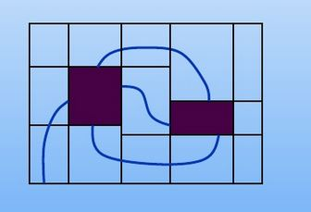
Region assignment
Assign routing regions to each net. Need to consider timingbudget of nets and routing congestion of the regions.

Slide 15
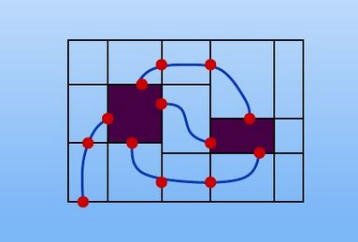
Pin Assignment
Assign pins on routing region boundaries for each net
(prepare for the detailed routing stage for each region ).

Slide 16
Approaches for Global routing
Sequential approach:
Route the nets one at a time.
Order dependent on factors like criticality, estimated wire length, etc.
If further routing is impossible because some nets are blocked by nets routed earlier, apply Rip-up and Reroute technique.
This approach is much more popular.

Slide 17
Approaches for Global routing (continued )
Concurrent Approach:
The major drawback of the sequential approach is that it suffers from the net ordering problem.
Consider all nets simultaneously.
Can be formulated as an integer program.

Slide 18
Maze Routing problem
Given:
A planar rectangular grid graph.
Two points S and T on the graph.
Obstacles modelled as blocked vertices.
Objective:
Find the shortest path connecting S and T.
This technique can be used in global or detailed routing (switchbox) problems.

Slide 19
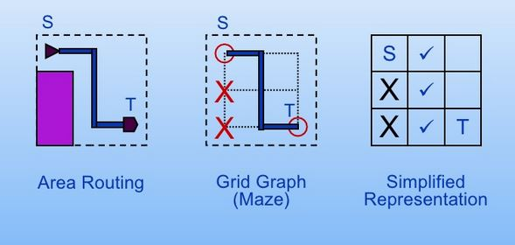
Grid graph

Slide 20
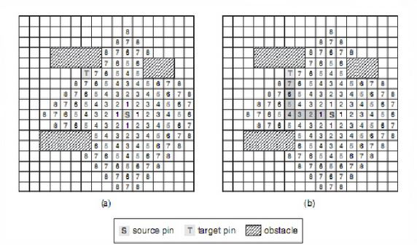
Maze routing

Slide 21
Detailed routing
Three types of detailed routing methods:
• Channel Routing
• 2-D Switchbox Routing
• 3-D Switchbox Routing
Channel routing → 2-D switchbox → 3-D switchbox
If the switchbox or channels are unrouteable without a large expansion, global routing needs to be done again.

Slide 22
Detailed routing continued
Channel routing:
channel may grow in one dimension to accommodate wires
pins generally on only two opposite sides.
Switchbox routing:
Switch box routing is harder than channel routing because we can’t expand the switchbox to make room for more wires
pins are on all four sides, fixing dimensions of the box.

Slide 23
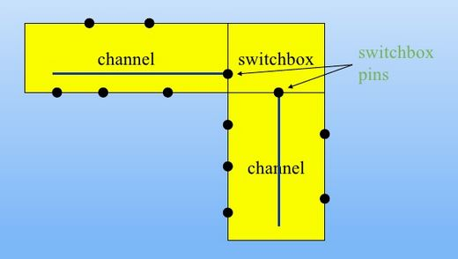
Channel and switchboxes

Slide 24
Types of channel junction
Three types of channel junctions may occur:
L-type: Occurs at the corners of the layout surface. Can be routed using channel routers.
T-type: The leg of the “T” must be routed before the shoulder. Can be routed using channel routers.
+-type: More complex and requires switchbox routers. Advantageous to convert +-junctions to T-junctions.

Slide 25
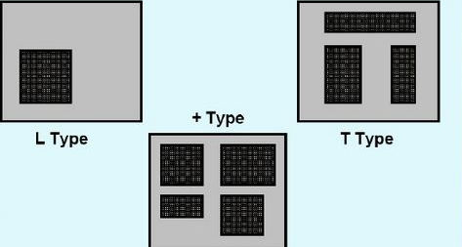
Types (continued)

Slide 26
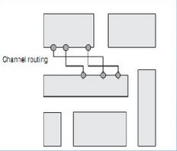
Channel routing
Channel routing is a special case of routing problems in which wires are connected within the routing channels
To apply channel routing , a routing region is usually decomposed into routing channels

Slide 27
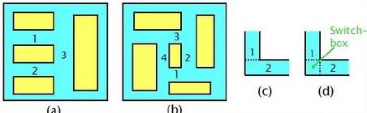
switchbox
a)Channels have no conflicts
b) Conflicting channels
c) Conflict resolved using L-shaped channels
• Order matters
d) Switchbox used to resolve the conflict
• Order matters
• Harder problem (compared to channel routing)

Slide 28
Extraction and timing analysis
After global routing and detailed routing , information of the nets can be extracted and delays can be analyzed .
If some nets fail to meet their timing budget , detailed routing or global routing needs to be repeated .

Slide 29
Routers available
NTHU- Route
Maize router
BoxRouter
Archer
FastRoute
Etc

Slide 30
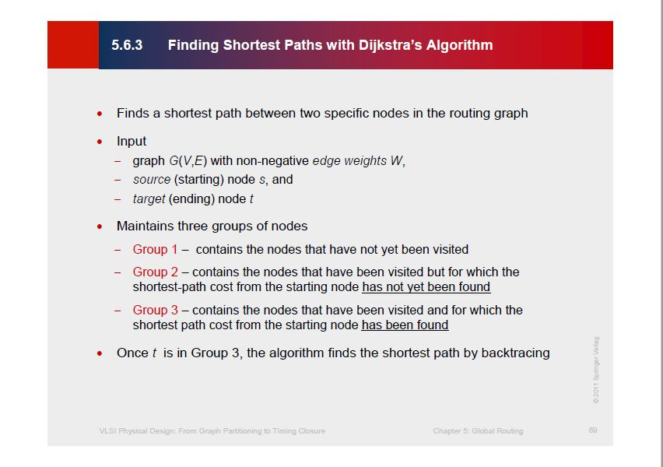

Slide 31
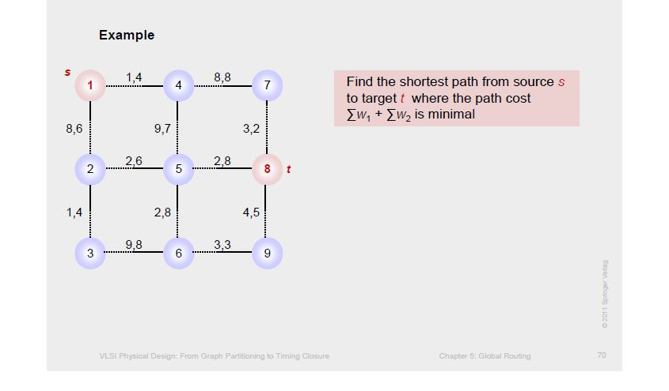

Slide 32
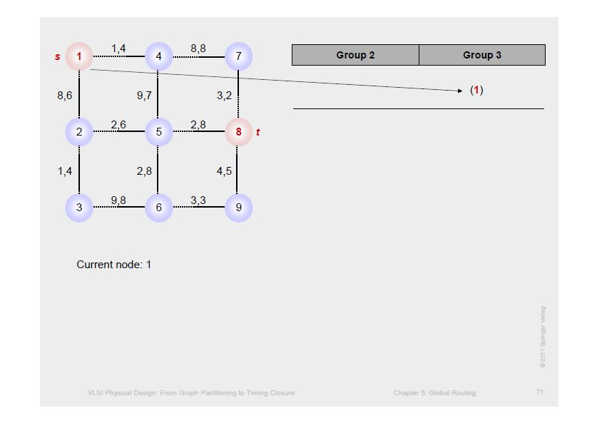

Slide 33
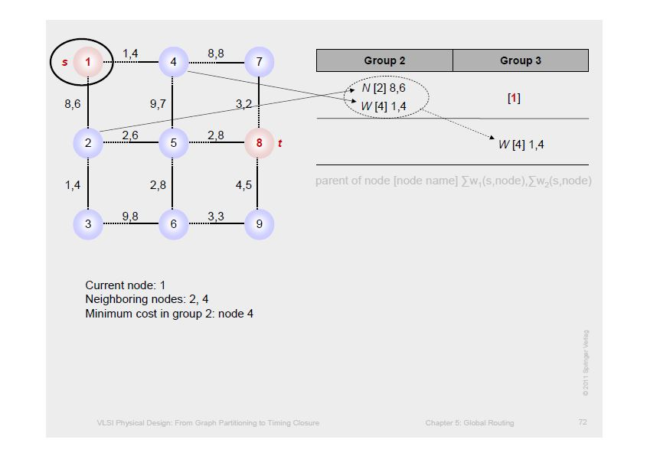

Slide 34
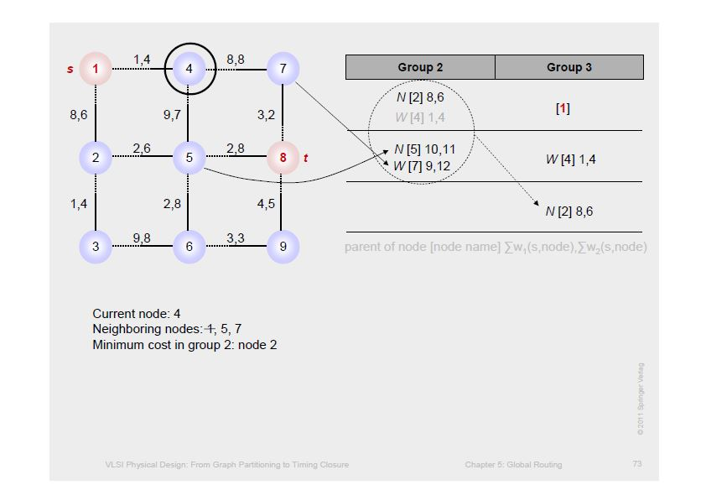

Slide 35
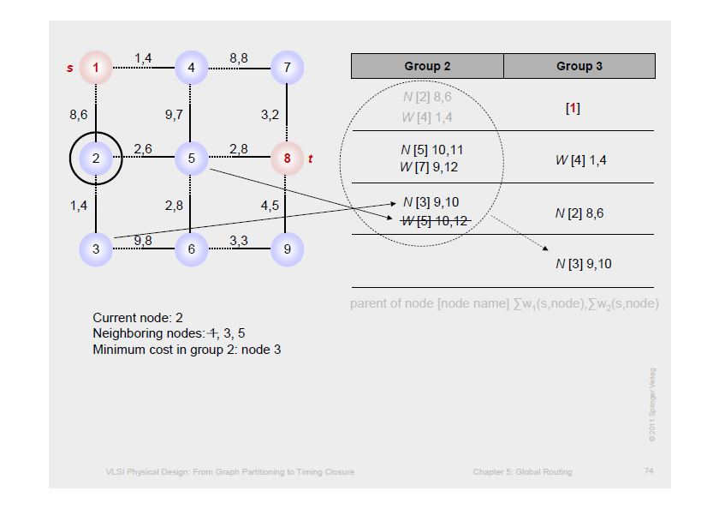

Slide 36
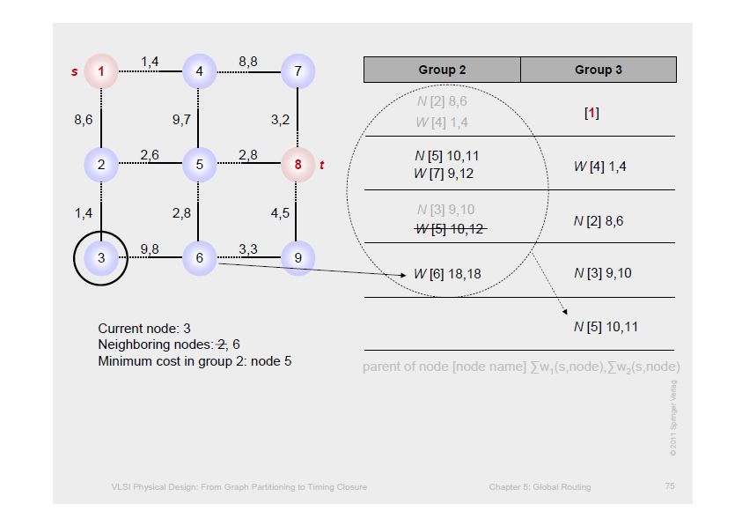

Slide 37
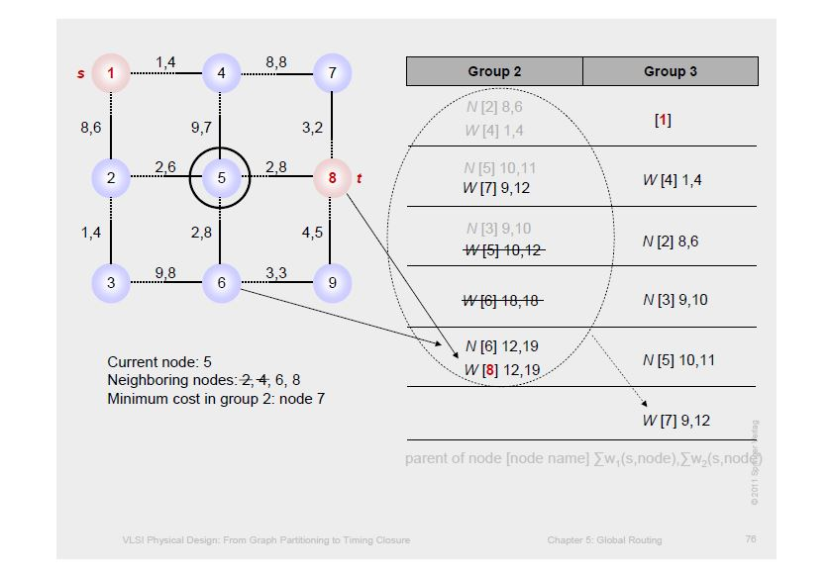

Slide 38
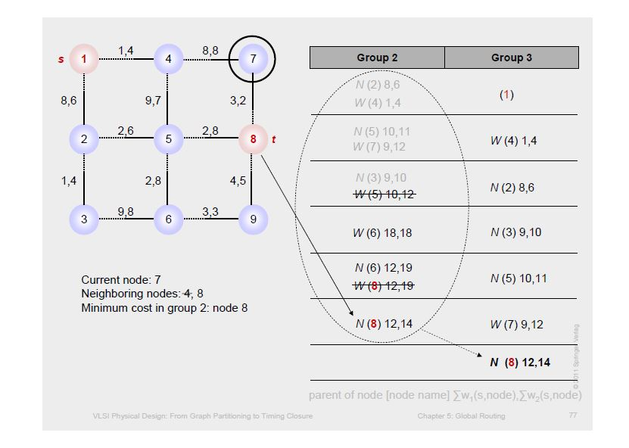

Slide 39
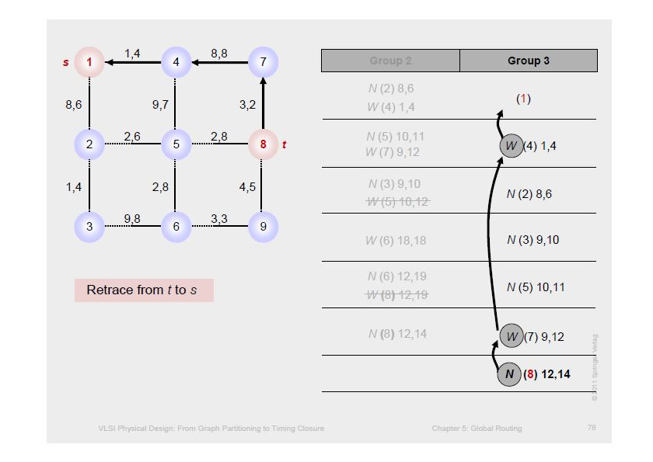

Slide 40
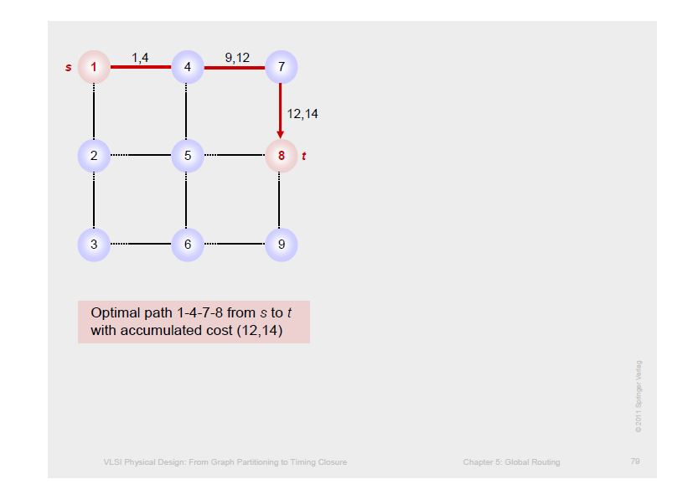

Slide 41
Conclusion
Routing is one of the most fundamental steps in the physical design flow and is typically a very complex optimization problem.
Effective and efficient routing algorithms are essential to handle the challenges arising from the fast growing scaling of IC integration.
We have discussed Global and Detailed routing techniques.
Routers will keep evolving with emerging design challenges such as nano-meter effects, signal integrity, reliability etc.

Slide 42
Reference
https://www.vlsiguide.com/2018/07/routing.html
https://www.slideshare.net/NaveenKumar11/vlsi-routing
https://www.ifte.de/books/eda/index.html

